Slide 1
Headscale VPN

Slide 2
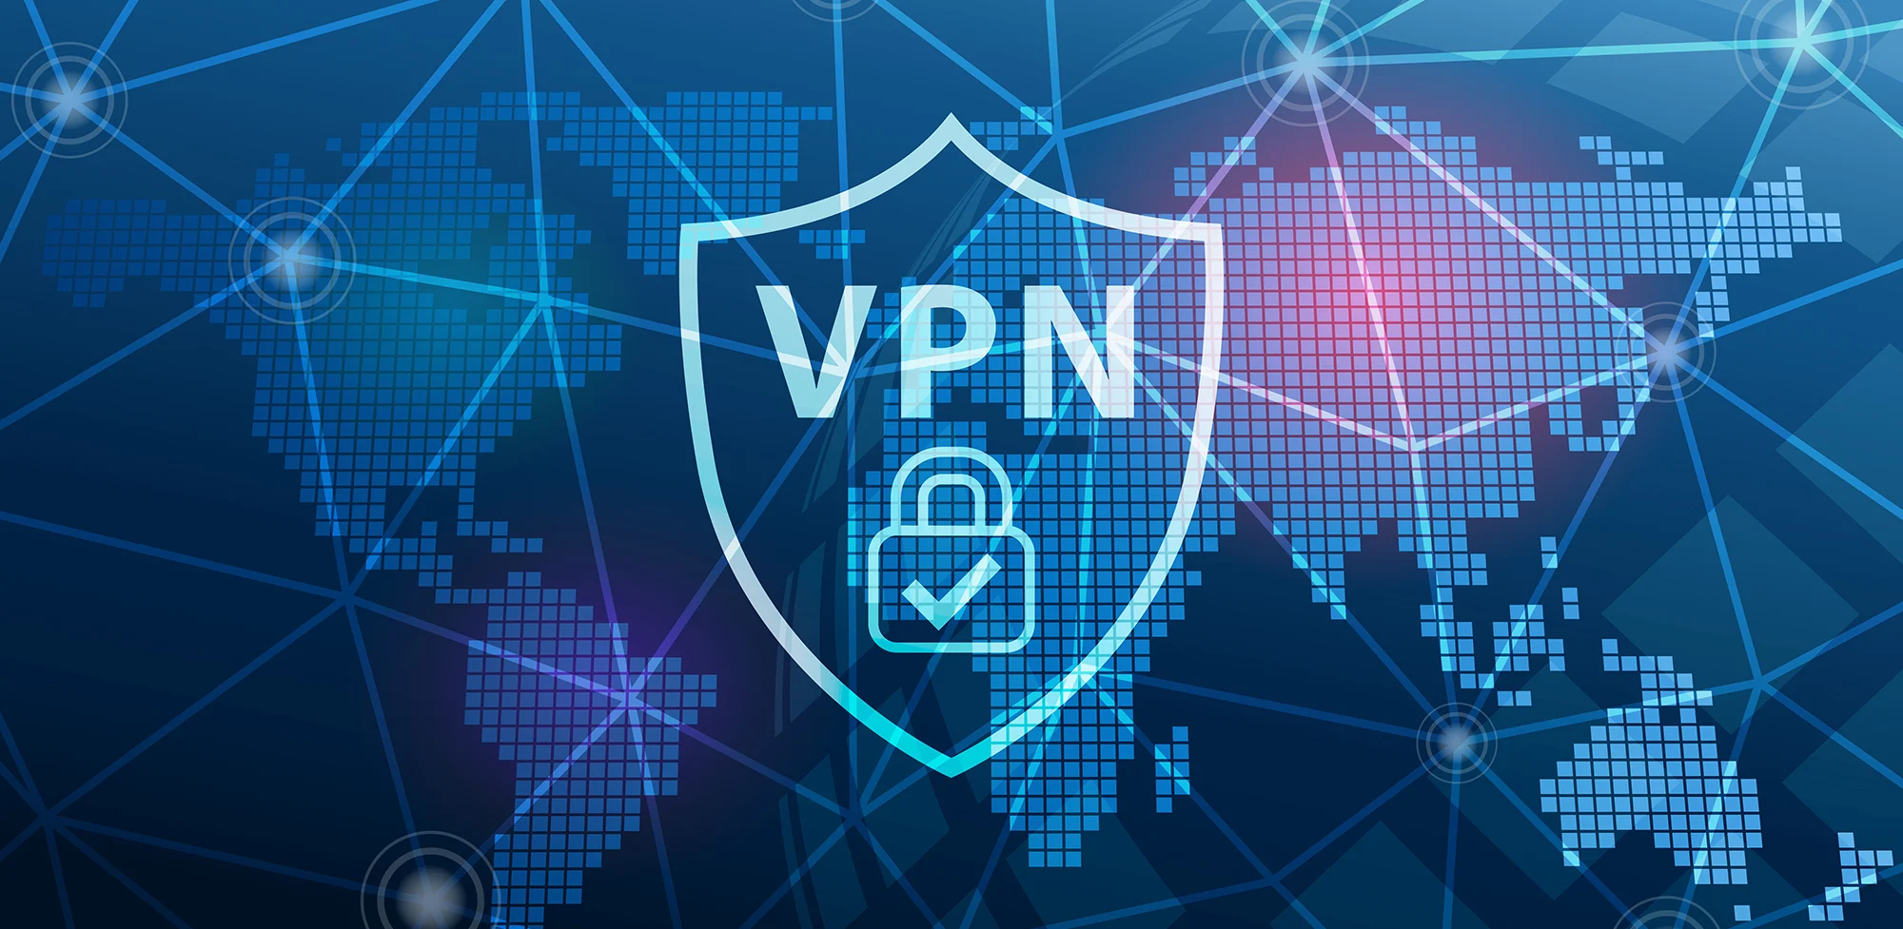
What?
V - Virtual
P - Private
N- Network
A VPN is what establishes a secure and reliable network connection over an unsecure
network such as the internet.

Slide 3
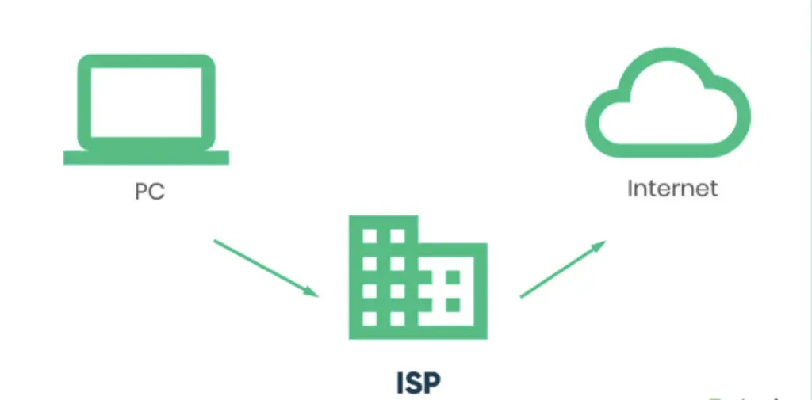
Why?
When connected to the Internet
through an Internet Service Provider(ISP),
all online activities can be monitored
and logged by the ISP. The main problem is that the ISP may share this information with third parties.

Slide 4
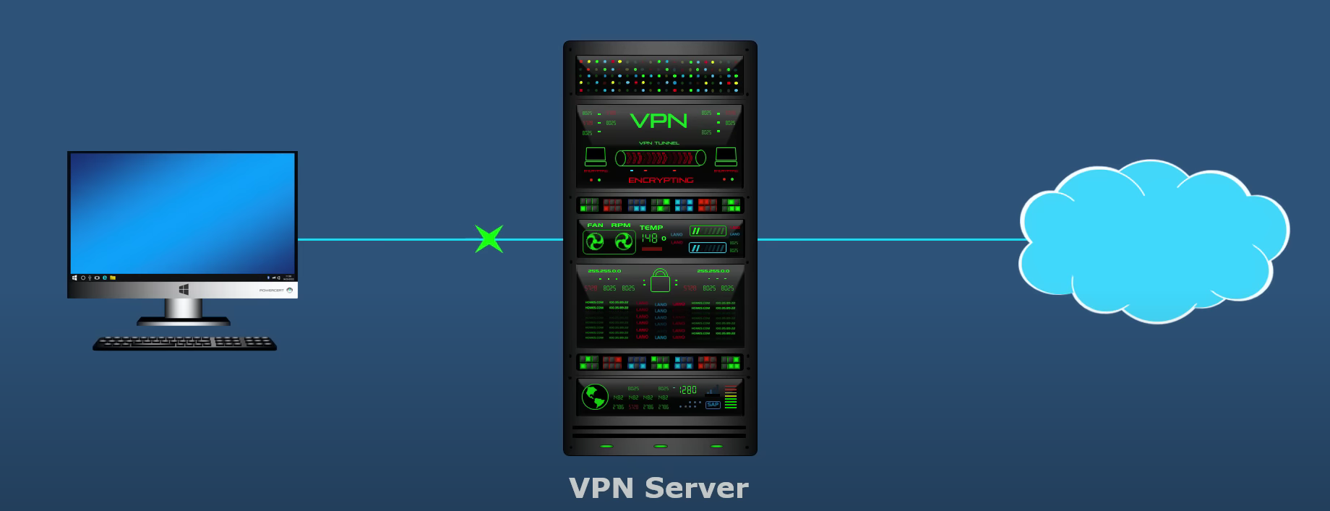
Solution?
The solution to safeguarding your online activities from ISP monitoring and
third-party sharing is to use a VPN.

Slide 5
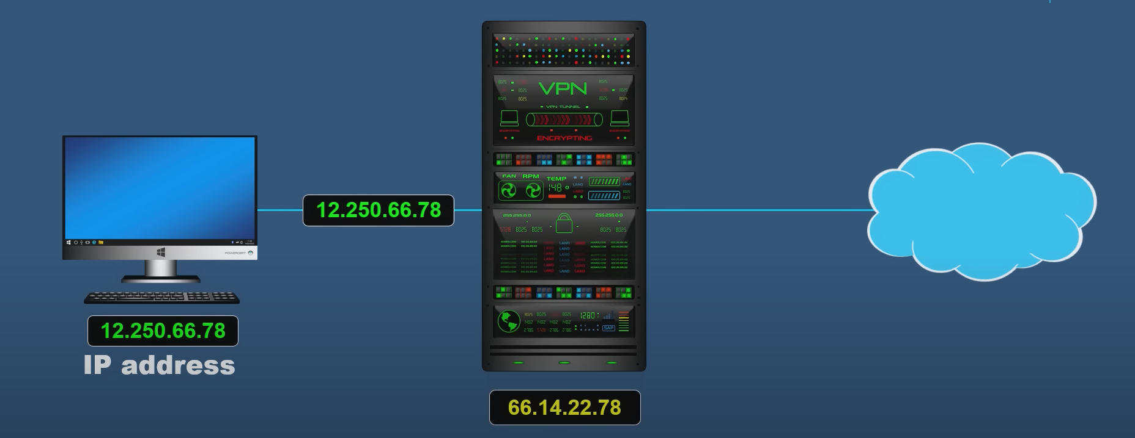
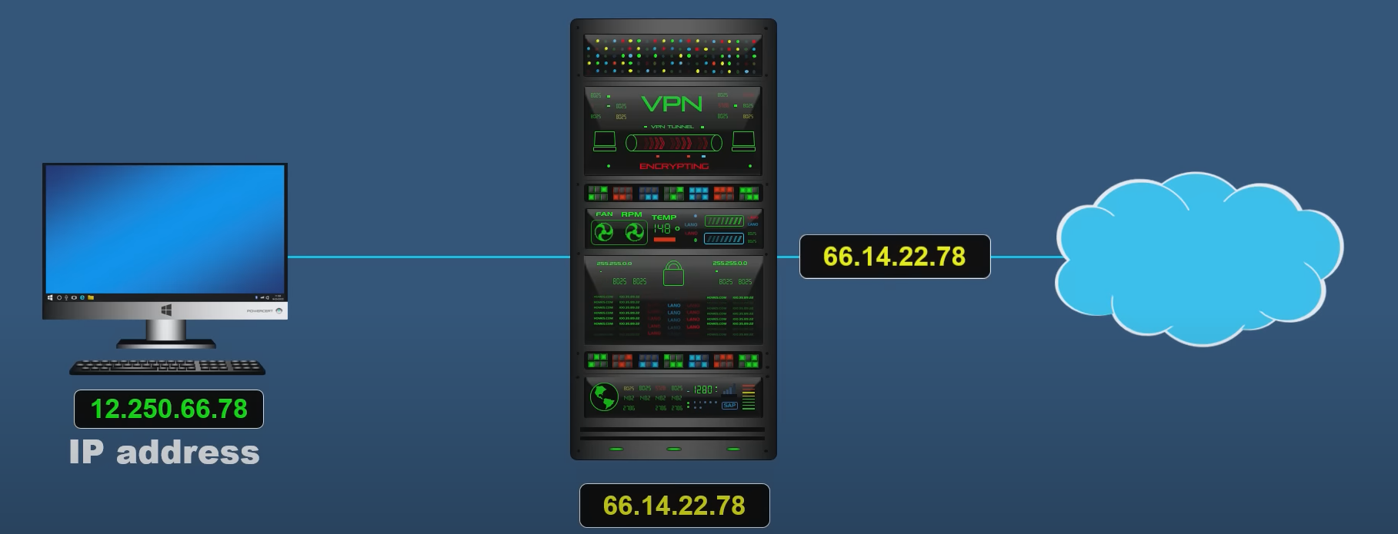
How?
By concealing your IP address, a VPN provides anonymity, allowing you to surf the internet discreetly and safeguarding your online identity.

Slide 6


How?
A VPN will encrypt and protect your internet data.
Whenever you go on the internet, the data that you send and receive is broken down into a bunch of smaller data packets.

Slide 7

How?
A VPN will encrypt and protect your internet data.
A VPN encapsulates the data with an extra layer of protection which is known as tunneling.

Slide 8

Uses
There are multiple resources on the internet that are banned from some countries and yet available in others.
You can trick the system using a VPN by using a VPN server available from a different country, which changes your IP address, which efectively changes your location, which will give you access to restricted internet content.

Slide 9
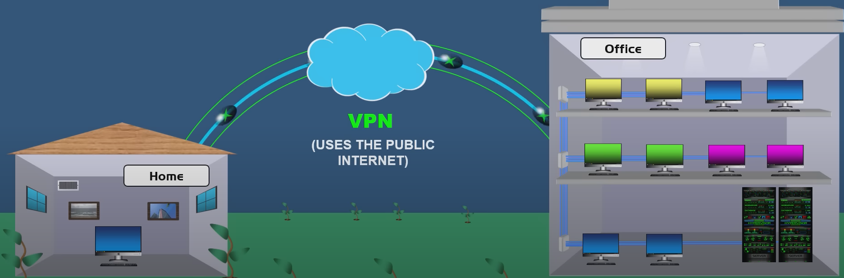
Uses
A VPN provides a secure connection for remote workers. The remote user can securely browse the internet using the public network, ensuring a safe online experience for him and the company.

Slide 10
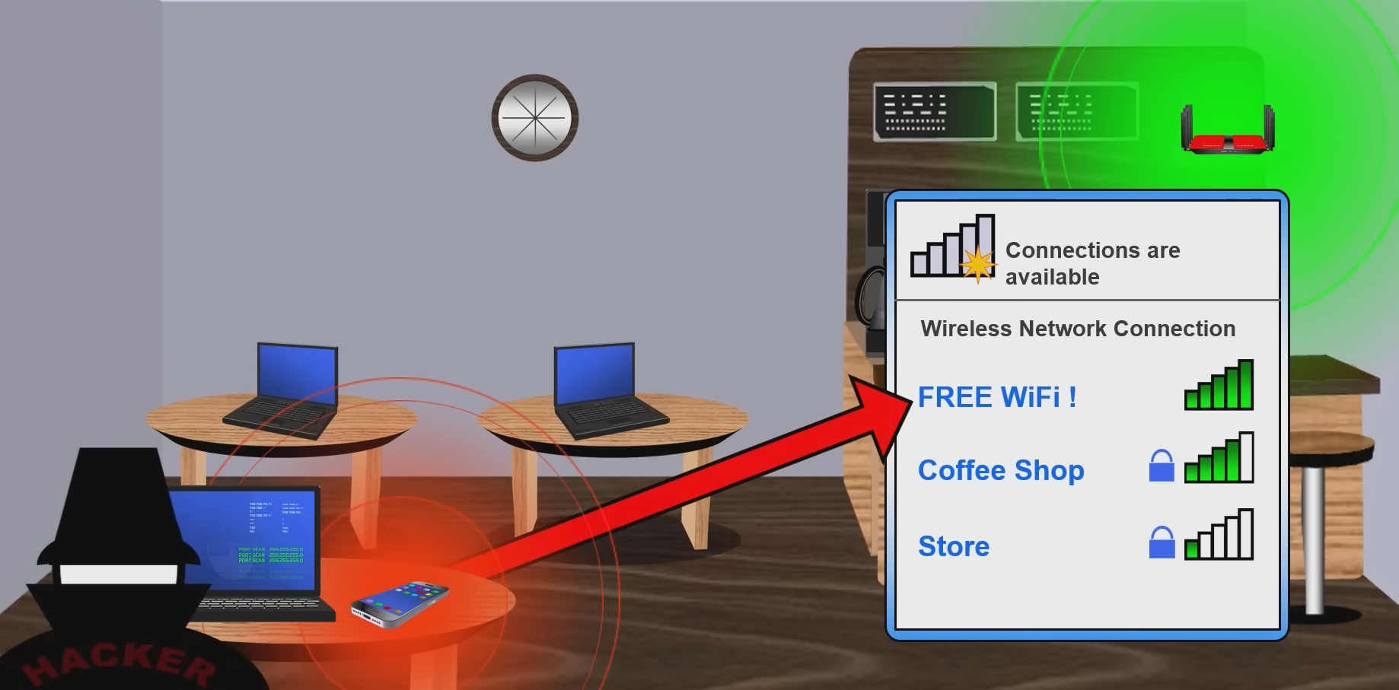
Uses
Any person that uses a public network can be the victim of a cyber attack. You can use a VPN to protect yourself.

Slide 11


What?
Headscale is an open source, self-hosted implementation of the Tailscale control server.
Tailscale is a software company based in Toronto. The company provides a zero config VPN as a service under the same name.

Slide 12
Why?
Why would you choose headscale over tailscale?
Headscale is the free version of Tailscale.
The traffic is rooted through Tailscale’s network.
Headscale gives you the posibility to deploy your server on your own infrastructure.

Slide 13
End
The end!
Realised by: Iancu Gheorghe-Aurelian

